Slide 2
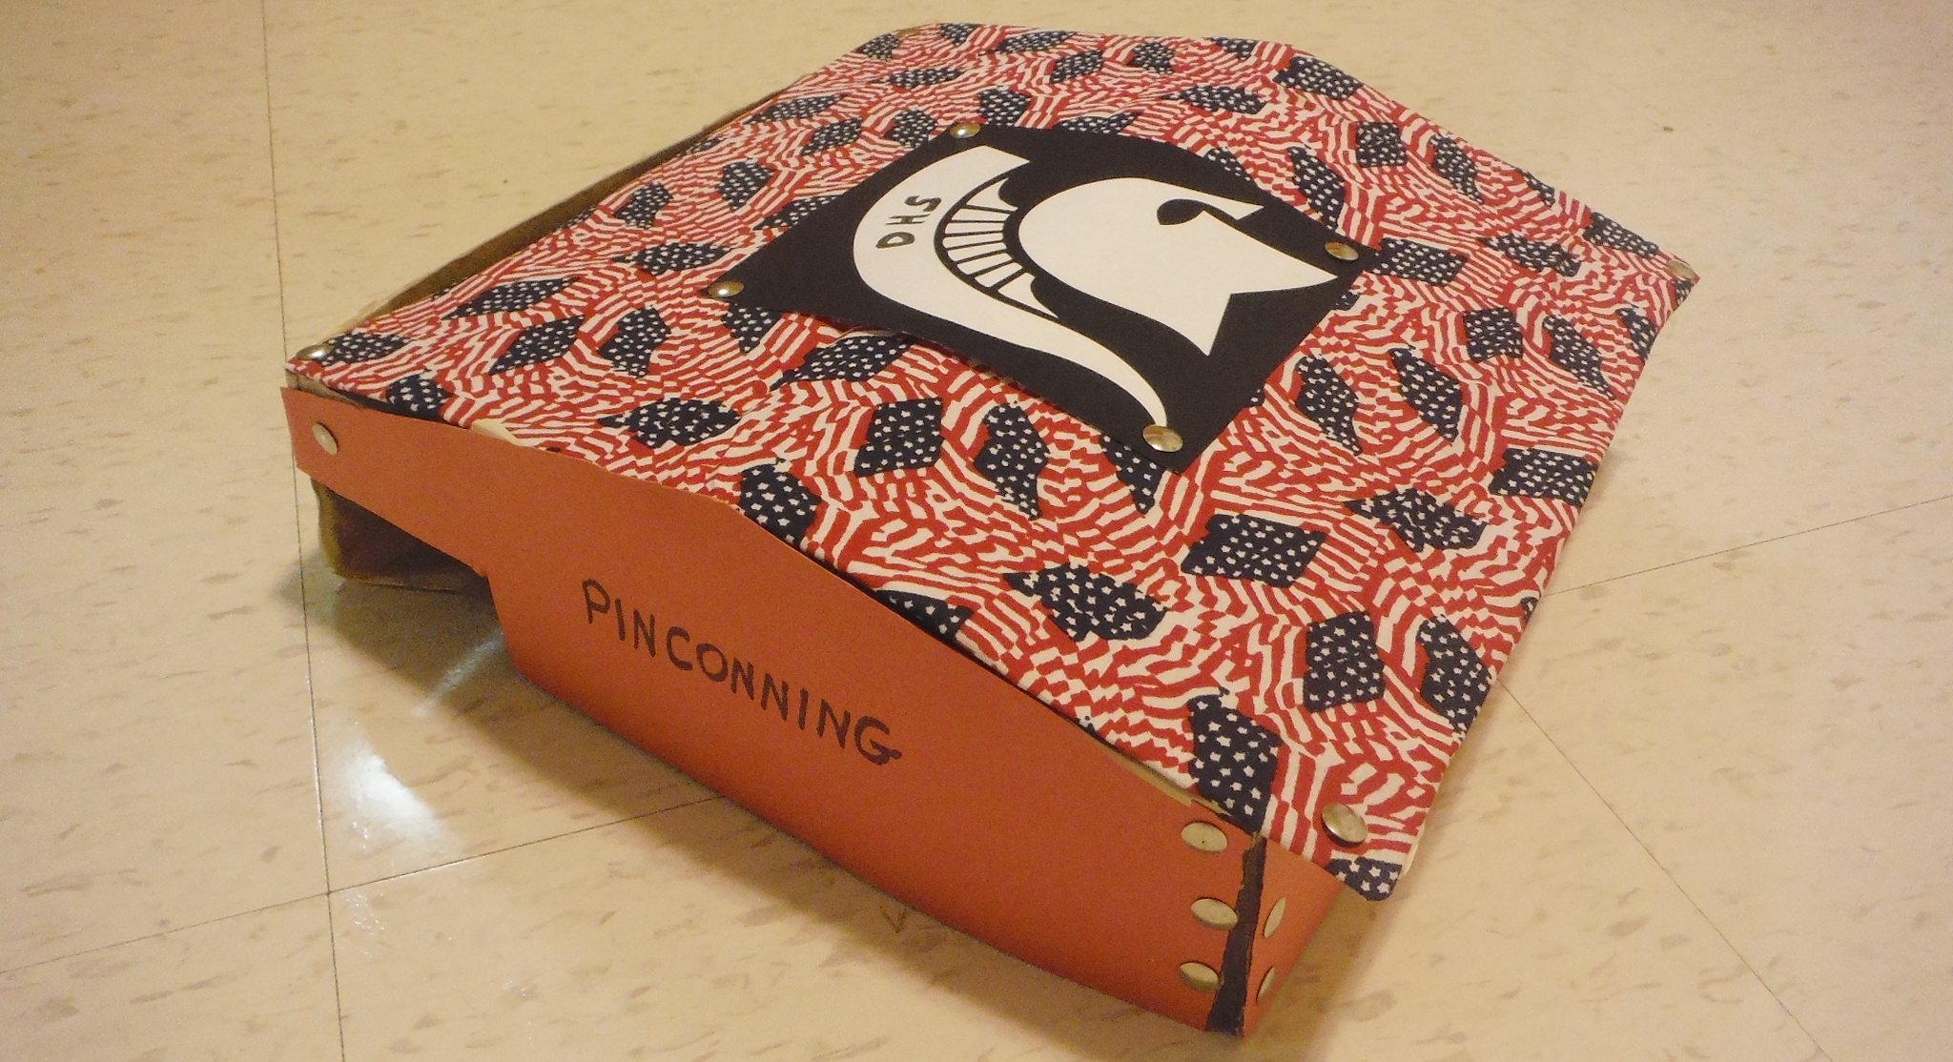
DHS HEADQUARTERS

Slide 3

DATA SPHERE

Slide 5
DHS HEADQUARTERS
Pinconning, Michigan

Slide 7
BOT-TEAM SIX
Ruston, Louisiana

Slide 9
DHS HEADQUARTERS
Pinconning, Michigan

